Slide 1
Front End Engineering-II Project
Travel Website- LiveLikeLocals
TEAM DETAILS:
GRACY (TEAM LEADER) 2310991827 (20-B) gracy1827.be23@chitkara.edu.in
DRIKSHA THAKUR 2310991822 (20-B) driksha1822.be23@chitkara.edu.in
AMISHA PUNDIR 2310991771 (20-A) amisha1771.be23@chitkara.edu.in
Supervised By Batch-2023; G-20; Semester - III
Thirupathy M & Dr.Yogesh
Chitkara University Institute of Engineering and Technology,
Chitkara University, Punjab

Slide 2
Abstract
LiveLikeLocals is a travel website that helps travelers experience local culture by connecting them with local hosts and guides. Instead of focusing on popular tourist spots, the platform offers activities like learning traditional cooking, visiting local neighborhoods, and attending festivals. This way, travelers can explore places in a more authentic and personal way.
The website also supports sustainable tourism by helping local businesses and preserving cultural traditions. By building real connections between travelers and locals, LiveLikeLocals makes every trip more meaningful and memorable.

Slide 3
Table of Contents
Introduction
Problem Statement
Key Features
Code Snippets
Output
Project Github Link
Conclusion
References/Links used

Slide 4
Introduction
Background
Travelers now seek immersive experiences that connect them with local cultures.
Offering authentic travel is important because it:
Promotes cultural immersion and deeper engagement.
Fosters personal connections with local hosts.
Supports sustainable tourism and local economies.
Provides unique, one-of-a-kind experiences.
This trend enhances travel while benefiting local communities.

Slide 5
Introduction
Objectives
To provide travelers with authentic, local experiences that promote deeper cultural immersion.
To foster personal connections between travelers and local hosts, enhancing the travel experience.
To promote sustainable tourism by supporting local businesses and preserving cultural heritage.
To offer unique, memorable experiences that go beyond traditional tourist attractions.
These objectives aim to create a more meaningful and responsible way for travelers to explore new destinations.

Slide 6
Introduction
Significance
LiveLikeLocals meets the demand for meaningful travel by providing authentic, community-based experiences that go beyond traditional tourism. This platform allows travelers to engage deeply with local culture through everyday activities and traditions.
By connecting travelers with local hosts, it fosters cultural exchange and supports small businesses, benefiting the local economy and preserving cultural heritage.
Ultimately, LiveLikeLocals offers a unique and personalized way to explore destinations, making journeys more enriching and memorable.

Slide 7
Problem Statement
In today’s travel landscape, there is a growing demand for personalized and authentic experiences that allow travelers to connect meaningfully with local cultures. However, many travelers struggle to find reliable platforms that offer such immersive experiences. Most existing travel websites focus on conventional tourist packages, which often lack the cultural depth that modern travelers seek.
This gap highlights a significant need for platforms that provide true cultural immersion and facilitate exploration beyond standard tourist attractions, enabling travelers to engage more deeply with the communities they visit.

Slide 8
Key Features
Authentic Local Experiences: Offers activities like traditional cooking and walking tours giving travelers a personal connection to the culture.
Cultural Immersion: Prioritizes deep engagement with local traditions over mainstream tourist attractions.
Support for Local Businesses: Promotes sustainable tourism by aiding local economies and helping preserve cultural heritage.
Personalized Travel Journeys: Provides a platform for travelers to create more meaningful and memorable trips by engaging with local hosts and unique experiences.

Slide 9
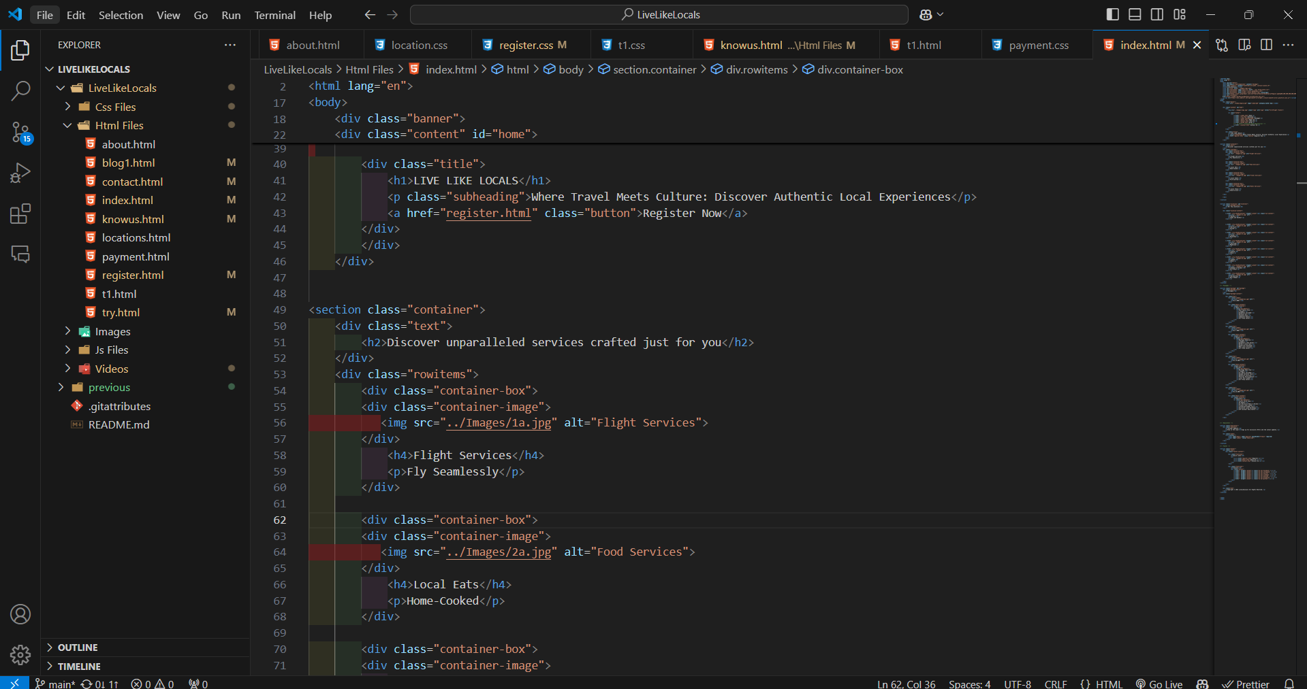
Code Snippets

Slide 10
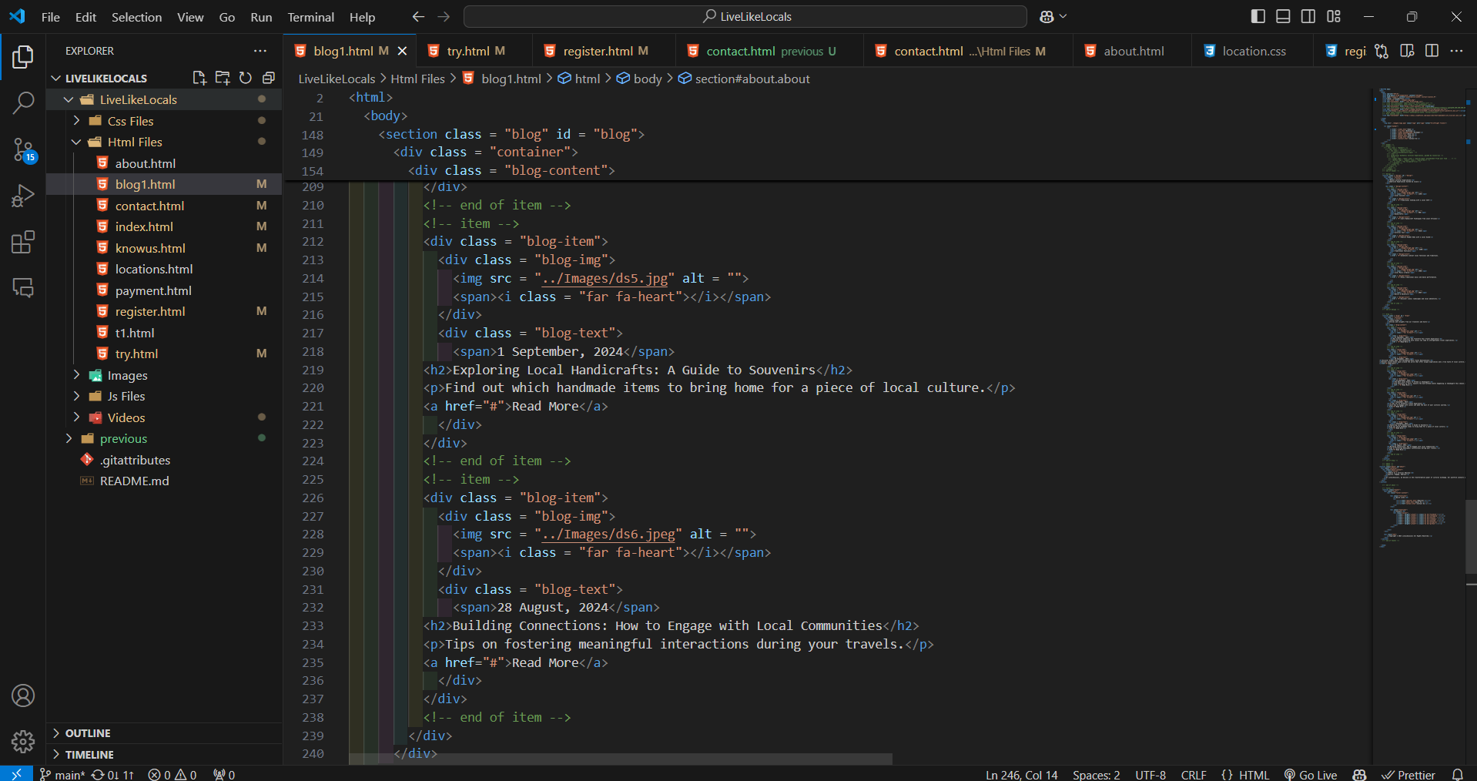

Slide 11
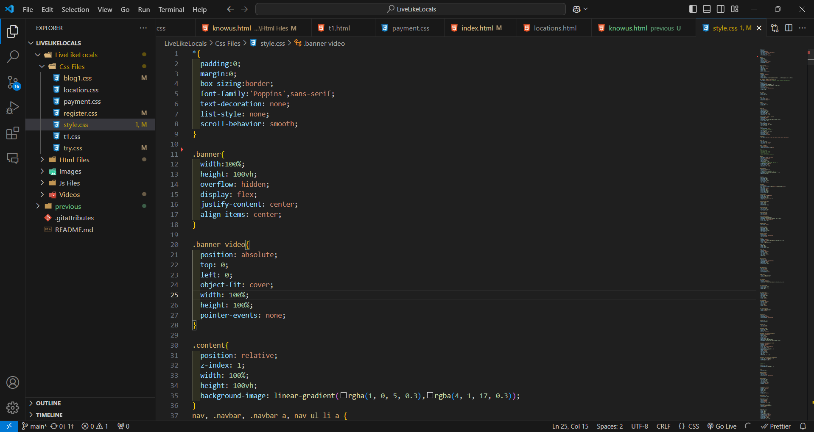

Slide 12
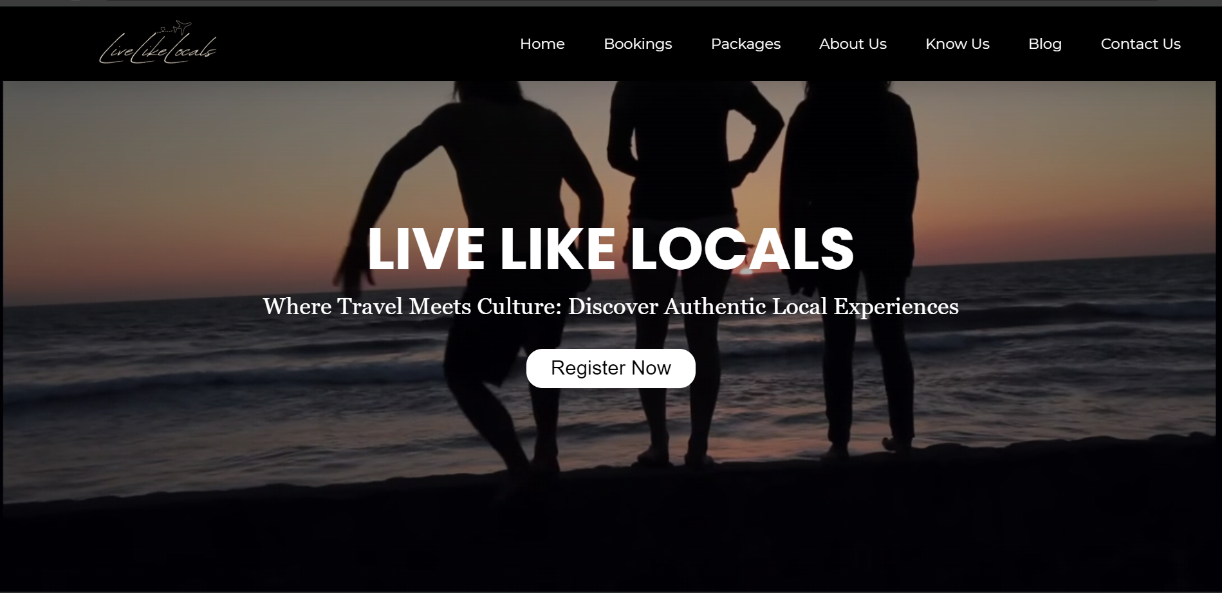
Output

Slide 13
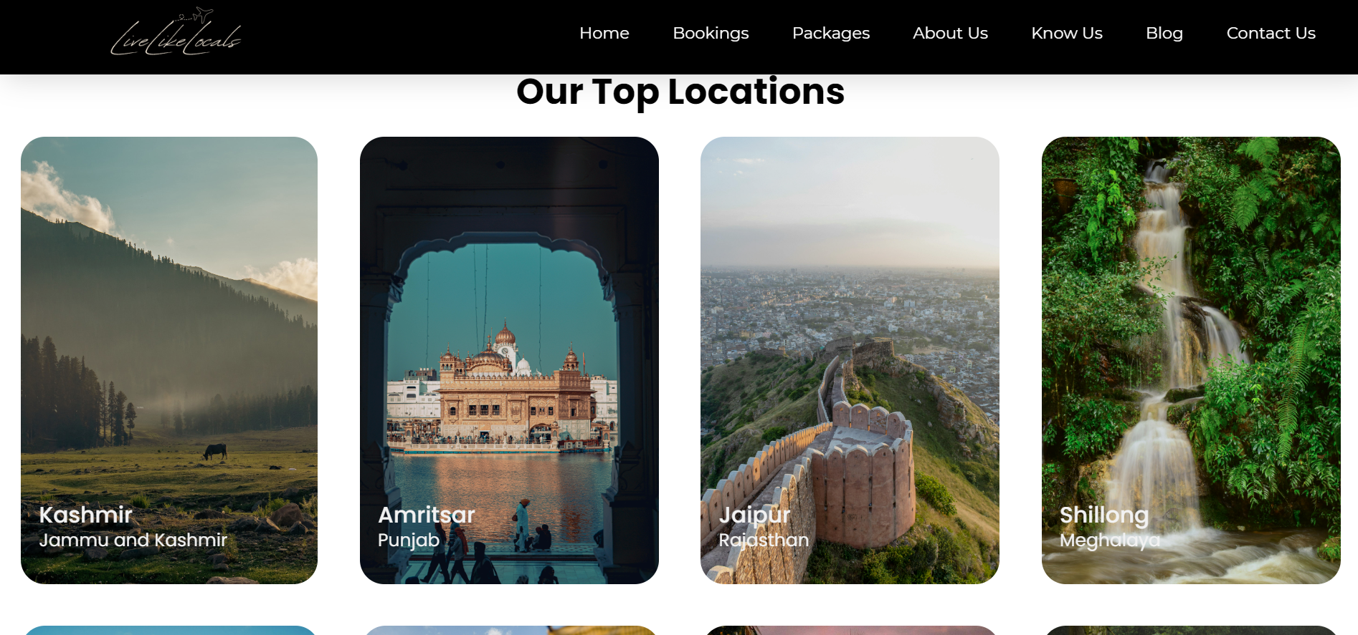

Slide 14
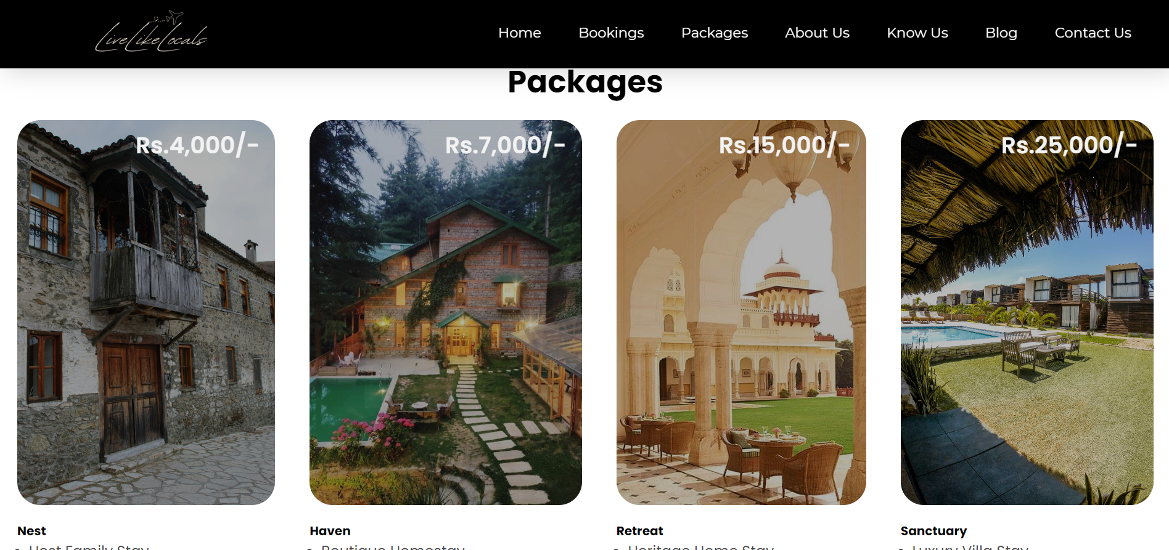

Slide 15
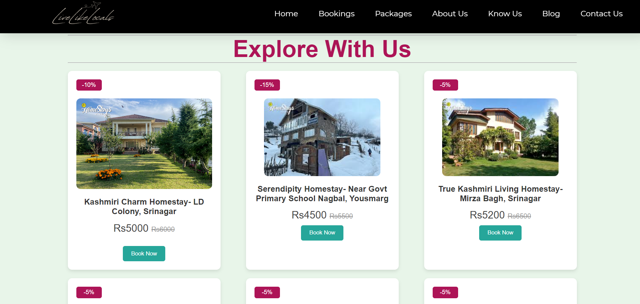

Slide 16
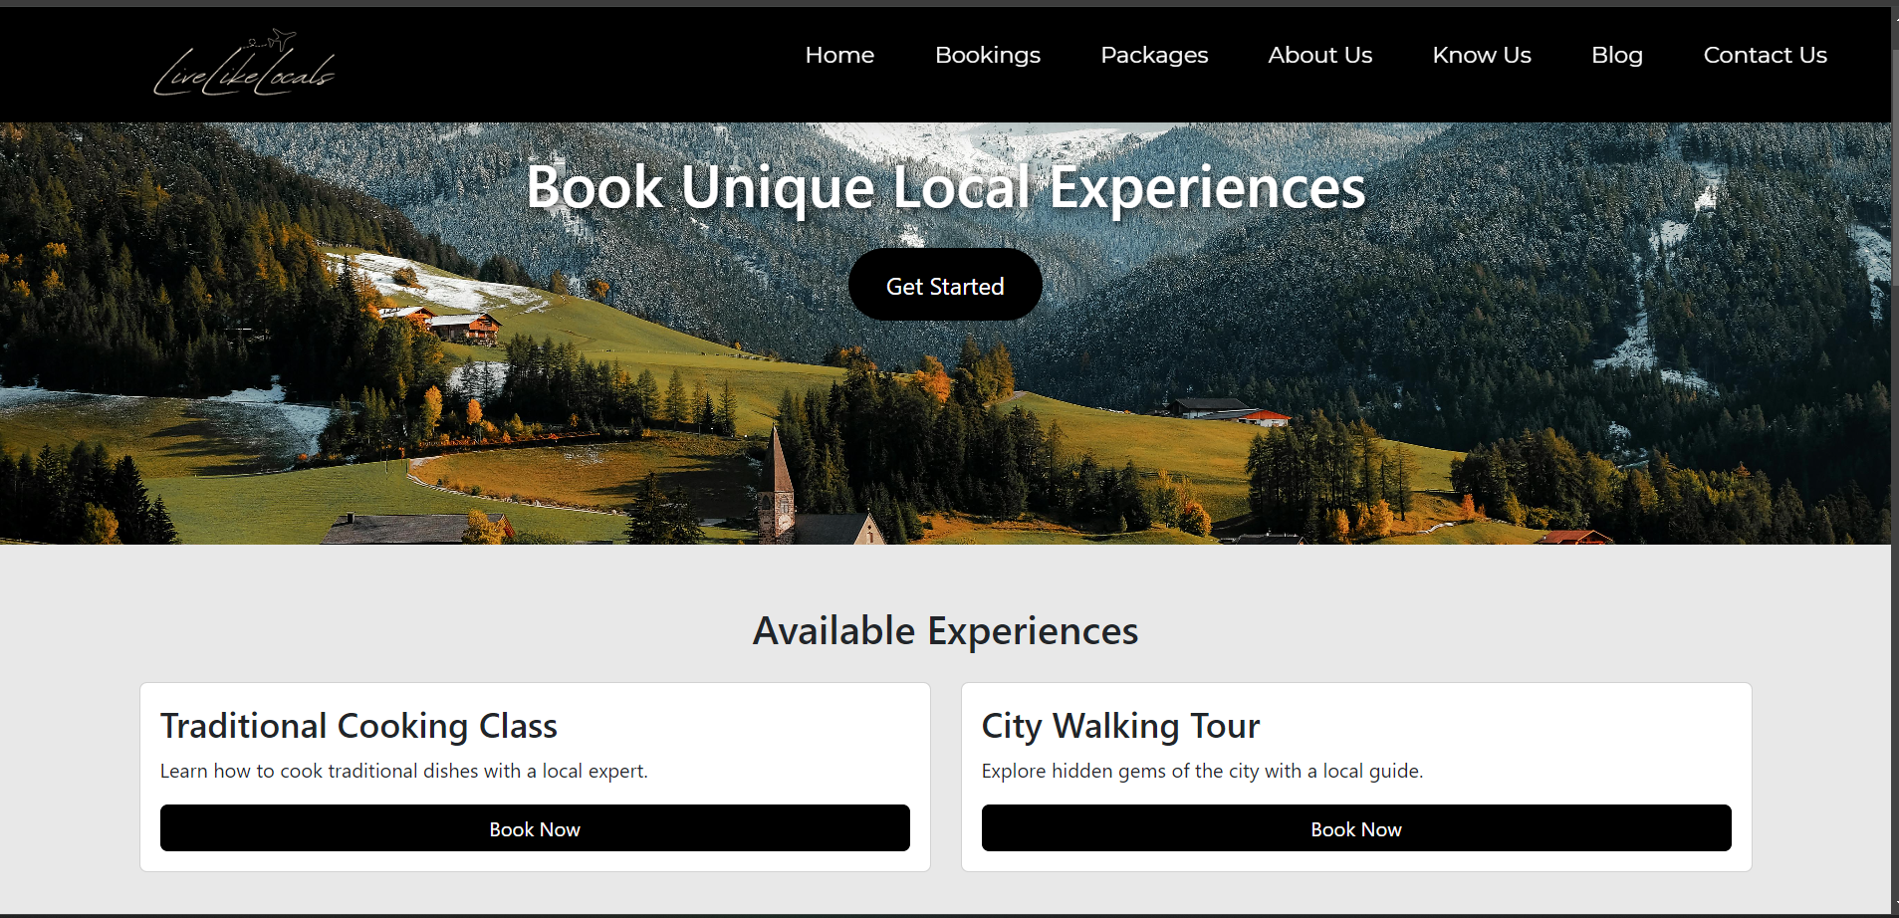

Slide 17
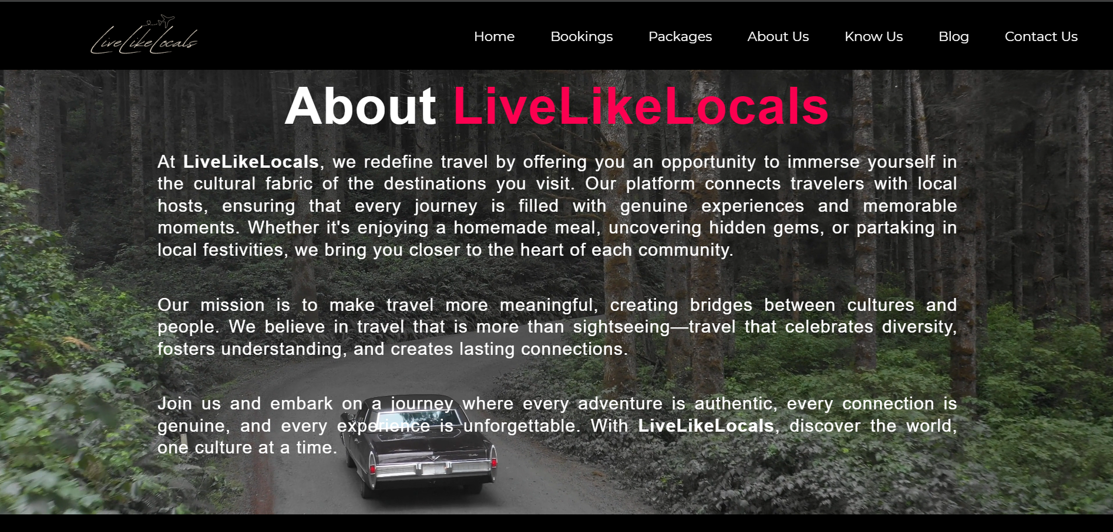

Slide 18
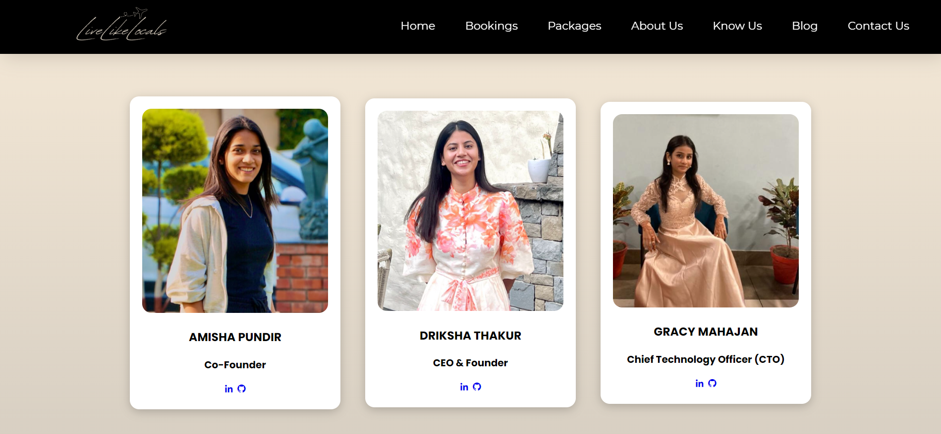

Slide 19
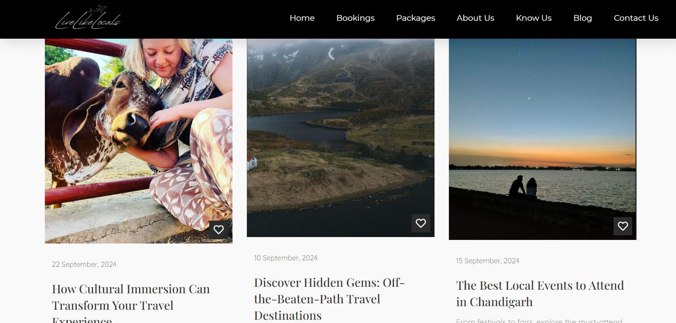

Slide 20
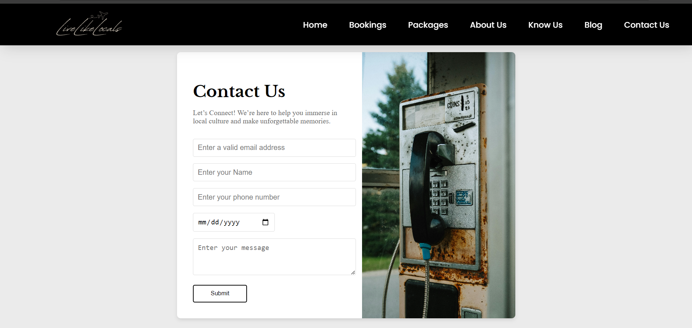

Slide 21
Project Github Link
https://github.com/drikshathakur786/LiveLikeLocals

Slide 22
Conclusion
LiveLikeLocals transforms travel by offering authentic, immersive experiences that connect travelers with local cultures. By engaging in activities like traditional cooking and festivals, travelers gain deeper cultural insights while supporting local businesses and sustainable tourism. The platform fosters meaningful connections, enriching both the traveler's journey and the host community, making each trip more memorable and impactful.
This platform not only benefits travelers by giving them personalized and meaningful experiences but also supports local businesses and helps preserve cultural heritage. Ultimately, it transforms travel into a journey of connection and cultural appreciation, making every trip memorable and significant for both the traveler and the host community.

Slide 23
References/ Links used
https://www.w3schools.com/tags/tag_html.asp
https://www.w3schools.com/w3css/w3css_tags.asp
https://youtu.be/cgV2tN8gxCg?si=l7DSff_kZgZObvwo
https://youtu.be/6AxnXWaDL-U?si=ojHgTsOU8sd4Siu1

Slide 24


